Slide 1
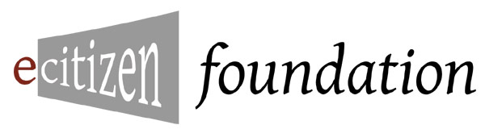
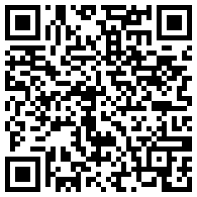
Public Meeting Notices and Agendas
November 9, 2010
eCitizen Foundation
https://docs.google.com/present/view?id=dfxgcdfc_292g3m8jqn9

Slide 2
Mission
Create a checklist for publishing a meeting notice with an agenda that makes it easier for citizens to learn about and participate in public meetings:
The checklist will stress methods and incorporate standards that are inclusive and as open as possible (OPIA- Open, Public and Integrated Architecture).
Specifically, the requirements gathering will concentrate on three aspects of any public system architecture: the business layer, the legal issue layer and the technological implementation layer (BLT methodology).
In addition, there will be a focus on the sociological aspects such as marketing and social networking.

Slide 3
Part One: Comprehensive Understanding of the Problem
First Step:
Look at the current state of the use of online meeting notices and agendas.
Identify systems being used by jurisdictions
Identify systems in use by other types of users
See how or if meeting notices are currently found and/or aggregated
List standards being used for
calendars, e.g. iCal
agendas
contact info
syndication
Identify other related efforts

Slide 4
Part One: Comprehensive Understanding of the Problem
First Step:
Look at the greater ecology of:
Scheduling for social, business and personal events
Relevant published laws, official proceeding publishing
Laws, motions and other products of the meeting
Testimony given before, during and after, and dealing with submission, publication and archiving
Identity systems for participation control
Open government data harvesting
Although, most of the above are outside the scope, these and others should be thought about in terms of the public meeting notices being part of that greater ecology.

Slide 5
Part One: Comprehensive Understanding of the Problem
Second Step:
In order to frame the research and requirements gathering for this project, we will use the BLT methodology:
B is for Business Process
L is for Legal Issues
T is for Technology Implementation
This will help us have a thorough examination of the problem space in order to avoid wrong paths or false assumptions before they can be baked into the solutions.

Slide 6
Part One: Comprehensive Understanding of the Problem
Step 2 cont.
We will list requirements and potential resources by BLT areas.
Dangers of not using BLT methodology:
Picking a calendaring system before checking with legal counsel who points out accessibility requirements for web sites used by municipality.
Also, tech solution providers may talk about features, but they may not map well to business process issues like approval chain (major CYA issue for an office).

Slide 7
Part One: Comprehensive Understanding of the Problem
Step 2 cont.
B examples:
Cost and resources
Support staff capabilities
Internal Approval Process
Vendor issues
Training
Logistics
Coordination between departments, for example planning, press relations and publishing
Customer support

Slide 8
Part One: Comprehensive Understanding of the Problem
Step 2 cont.
L examples:
Sunshine requirements, e.g. 30 day notice, publish in local paper, etc.
Accessibility for material and meeting location
Who can attend, participate, testify, vote
Minutes, Roberts Rules of Order, as pertaining to agenda
Post meeting reporting, transcripts, notice of votes
Citing all applicable rules and regulations relevant to the notice, the meeting and the agenda

Slide 9
Part One: Comprehensive Understanding of the Problem
Step 2 cont.
T examples:
Standards for data
Accessibility systems e.g. closed caption
Software, CMS, syndication, domains, APIs
Archive systems

Slide 10
Part One: Comprehensive Understanding of the Problem
Step 2 cont.
We will list requirements and potential resources by BLT areas.
Dangers of not using BLT methodology:
Picking a calendaring system before checking with legal counsel who points out accessibility requirements for web sites used by municipality.
Also, tech solution providers may talk about features, but they may not map well to business process issues like approval chain (major CYA issue for an office).

Slide 11
Part One: Comprehensive Understanding of the Problem
To accomplish steps 1 and 2, report to group or post directly to Wikibook
for current examples, add to
http://en.wikibooks.org/wiki/Public_Meeting_Notices_and_Agendas...
please add both generic and your own organization's B, L and/or T requirements at
.../Resources,_Standards_and_Ideas_to_Consider

Slide 12
Part Two: Designing a Citizen Centered Solution for Public Meeting Notices
At the core of a solution is reaching the goal--having citizens fully participate in democratic processes through knowing about how to attend and being prepared for public meetings.

Slide 13
Part Two: Designing a Citizen Centered Solution for Public Meeting Notices
As part of an Open, Public, Integrated Architecture
Open standards as appropriate
The system should be as transparent and accessible as possible
Simple solutions that integrate with all media, platforms and other systems
Note that this is an architecture/design process, starting with modeling before building

Slide 14
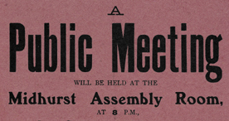
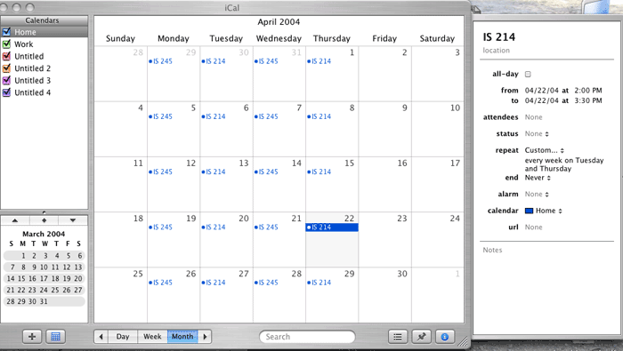
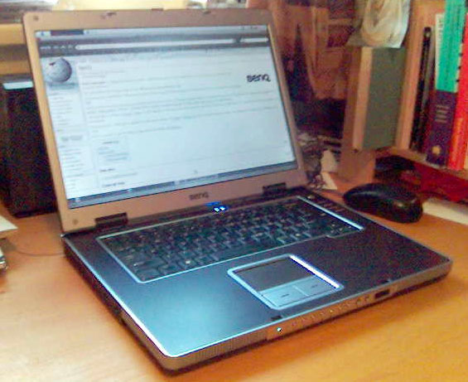
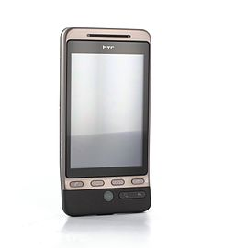

Part Two: Designing a Citizen Centered Solution for Public Meeting Notices
MEDIA/PLATFORMS

Slide 15
Part Two: Designing a Citizen Centered Solution for Public Meeting Notices
Designing for Simplicity, Interoperability and Authoritativeness
There should be one authoritative version
There should be a unique and universal identifier for the meeting and most parts of the notice and agenda
When possible, human readable media should also be machine processable and vice versa

Slide 16
Part Two: Designing a Citizen Centered Solution for Public Meeting Notices
URLs serve as a universal and unique identifier
URLs for authoritative web page for an event
URL fragments for each agenda item
URLs for bar codes
URLs for jurisdictions, legal cites and other metadata
Advantages:
Any municipality can create their own identifiers using their domain and know that there will not be data collisions.
And it is practically free and dead simple.
No need to coordinate with other entities, yet allow integration and aggregation.

Slide 17
Part Two: Designing a Citizen Centered Solution for Public Meeting Notices
Examples of URL for Public Meeting Notices and Agendas
URL for Event:
http://jurisdiction1.gov/meetings/2010/11/planning
All of the information can be gotten from this authoritative and updated notice page.
Page can link to other documents (e.g. iCal)
Page can incorporate data.
Can be used in RSS, bookmarked, short URL'd, as bar code on printed docs, texted, etc.
Can be used for metadata systems with no collisions.

Slide 18
Part Two: Designing a Citizen Centered Solution for Public Meeting Notices
Examples of URL for Public Meeting Notices and Agendas
URLs for Agenda Items:
http://jurisdiction1.gov/meetings/2010/11/planning#agenda-1
http://jurisdiction1.gov/meetings/2010/11/planning#agenda-2
http://jurisdiction1.gov/meetings/2010/11/planning#agenda-3
Can embed div or li id tags into HTML event page.
Or can be links to external pages that are more "authoritative."
Each item can be bookmarked, cited, linked to, etc.
The div section can include separate meeting times and other logistical data, who can participate...

Slide 19
Part Two: Designing a Citizen Centered Solution for Public Meeting Notices
Examples of URL for Public Meeting Notices and Agendas
URLs for Jurisdiction Entity Identifier/Naming:
http://jurisdiction1.gov/planningboard
Will always work as unique identifier for the web
Federated approach possible as well as independent naming
Usually will contain data at the page (or profile) such as
Links to related jurisdictions
Metadata tags and URLs for geo, topic, politcal hierarchy
Allows external aggregators to just know the URL to create lists as a URL is a simple, universal identifier where knowing other aspects possible, but not necessary
Easily related to other naming systems that use URLs
http://www.dc.gov to http://en.wikipedia.org/Washington-DC to http://census.gov/states/dc to http://travelinfo.com/us/dc to....

Slide 20
Part Two: Designing a Citizen Centered Solution for Public Meeting Notices
When possible, human readable media should also be machine processable
HTML should be valid and accessible.
http://validator.w3.org/
http://www.w3.org/WAI/
http://section508.gov/
http://www.icdri.org/test_your_site_now.htm
HTML can have data friendly portions
HTML/CSS/Javascript model separating content from design from coding
Smart use of "id" attributes for URL fragments
Use of RDFa and/or Microformats
Paper/physical media should always have a bar code for URL and OCR'able URL
see QR barcodes for URL

Slide 21
Part Two: Designing a Citizen Centered Solution for Public Meeting Notices
When possible, machine processable media should also be human readable
URLs should be "cool"- permanent and human understandable
http://www.w3.org/TR/cooluris/
XML documents should always have style sheets so humans can easily read the data
Data and Document formats that can not be both should be non-authoritative or secondary

Slide 22
Part Three: Checklist
Based on previous work and allowing for feedback:
Show requirements, current examples and resources
Create demo versions of PMNs and Agendas
Create draft checklist and best practices (in draft form at the Wikibook:
Link to resources
Have in Wikibook for free and printable form

